Slide 1
An Effective Teaching Pedagogy in Changing Business Education
Dr M Nishad Nawaz MBA., MHRM., M.Phil.,Ph.D. Dr Anjali Mary Gomes M.Com.,B.Ed.,Ph.D. Email Id: nnawazm@gmail.com Email Id: anjali551@yahoo.co.in
College ofAn Effective Teaching Pedagogy in Changing Business Education
Journal of Education and Practice www.iiste.org
ISSN 2222-1735 (Paper) ISSN 2222-288X (Online)
Vol.5, No.19, 2014
How does university teachers’ pedagogical training meet topical
challenges raised by educational research? A case study from Finland
Katarzyna , Paivikki , Paivi
ELSEVIER An International Journal of Research and Studies

Slide 2
highlights
The papers presents analytical models for examining university pedagogy .
Review reflects the complexity of learning, which challenges university teaching and teachers’ pedagogical training.
Findings revealed inadequate alignment of pedagogical training with global, societal and labour market needs and the need to address this gaps based on given recommendations.

Slide 3
Changing technology, economic conditions and strong global competition has made management education’s role increasingly central, in the success of individuals and industry.
Management education needs a critical examination, as only developing talent can take the world forward. Global competition is changing and so is the relationship of management education and business
Management education is a process of leading in thought and action. Today there is a lack of focus on holistic education for the students aspiring to pursue Management Education.
In the present corporate world a lot of attention is given to the management education across the academic world
The studies I am about to share are engaged on the revamping of Teaching Pedagogy in Management Education as a prelude to better participation and viability in the world economy.

Slide 4
Research Questions
What kind of themes related to university pedagogy emerge from educational research?
How do the research themes identified in the literature review (RQ1) appear in the written curricula of university pedagogical courses?
How do the research themes identified (RQ1) emerge in the experiences of the participants and trainers of university pedagogical courses?
How does pedagogy change the future of the student career (You can not change the future of the student career. But you can change the pedagogy; it will change the future of the students’ career)

Slide 5
Methodology
Both Papers used secondary data
The studies started by examining the competences needed in university teaching and adopted initial themes, which were elaborated in further analysis.
Supplementary literature was found through the snowball method , which was applied to literature references of well-known scholars.
The analysis applied features of thematic analysis and abductive reasoning .
Initial main themes were based on previous theoretical structuring, whereas new themes and sub-themes were developed from the data.
During the analysis, the themes were elaborated until final formulations were reached.
A total of more than 300 research publications (mostly articles but also monographs) constituted the data base (supplementary file).

Slide 6
To ensure that management education is able to deal with;
global,
technological and
market changes,
It is imperative for business schools to use;
well up-dated curricula,
course materials,
teaching models,
various research methods that are not only up-to-date but also internationally competitive

Slide 7
The core competencies of a business schools offering management education lies in its unique and innovative teaching pedagogy, to enable meaningful learning and development of skill, sets that the employers think deem fit to employ.
These studies present system of management education and its pitfalls and presents how teaching pedagogy has to be developed to make management education process more strategically valuable and productive from the perspective of the stakeholders at large

Slide 8
You can not change the future of the student career. But you can change the pedagogy; it will change the future of the students’ career.
Management Education depend on the following Learning stages.
Learning for knowing new knowledge
Learning for doing /acting for survival
Learning for living together in any situation
Learning to continuously stand on champion position
Learning for innovations through Research
To attain Management Education, business schools should thus focus on;
creativity,
critical thinking,
communication and
collaboration to prepare students for the future
Most of the management concepts fall into the category of Bloom's Taxonomy. However, the 21 century learning process should be build on the basis of knowledge recall and comprehension, to use and apply skills, to analyze and evaluate process, outcomes and consequences and to create and innovate.

Slide 9
Creativity
Students respond well to real world problems . The delivery of knowledge in the learning process must be aligned to the following six levels of cognition.
Remembering
Understanding
Applying
Analyzing
Evaluating
Creating

Slide 10
Figure 1 Knowledge Creating Process
Creating
Knowledge Creation
Evaluating
Analyzing
Applying
Understanding Remembering
Knowledge Deepening
Knowledge Acquisition

Slide 11
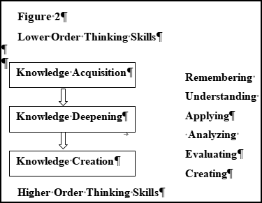
Critical thinking
While much of the knowledge faculty members teach may be obsolete after few years. Thinking skills acquired will remain with the student community for their entire life. In the 21st century, pedagogy mainly focuses on moving student from lower Thinking Skills to Higher Order Thinking Skills

Slide 12
Communication
Articulate thoughts and ideas effectively using oral, written and nonverbal communication skills in a variety of forms and contexts through faculty knowledge, pedagogical knowledge, content knowledge and curriculum knowledge.
Listening effectively and translating of the knowledge, values, attitudes, intentions and ethics through various classroom teaching
Use communication for a range of purposes (e.g. to inform, instruct, motivate, persuade and inspire) through research based examples
Utilize modern technologies, and know how to judge their effectiveness as well as assess their impact for the present and future professional development.

Slide 13
Collaboration
Collaboration is not a 21st century skill it is 21st century teaching methodology.
Collaboration is not limited to the confinement of the classroom. Management students and faculty members collaborate across the globe, and beyond the time constraints of the teaching day.
Students can collaborate with other students nationally, regionally and globally. Learners seek and work with experts as required.
It should be real world learning, inter disciplinary and live project based learning.
Learners have to focus on the real world problem rather than the abstract based/ theoretical based and they have to learn other specialization and not just their own specific specialization.
Even faculty members have to extend their areas of expertise, collaborate with their teaching peers in other subjects from learning in one discipline to learning in another.
Projects should bring together and reinforce learning across discipline (Shulman's theoretical framework . Fig. 3 & 4)

Slide 14
THE MODEL
Business schools should focus mainly on their;
Faculty knowledge,
Pedagogical knowledge,
Content knowledge
Curriculum knowledge and
Research Based Syllabi.
This will reduce gap between the real world problems faced by business education through outcomes (students) and large number of students will be benefited

Slide 15
Pedagogical knowledge, according to Shulman has broad principles and strategies of classroom management and its subject matter. It is all about the processes and practices or methods of teaching and learning
Curriculum knowledge is knowledge of what should be taught to particular group of students
In Shulman's theoretical framework, teachers need to master two types of knowledge:
(a) content, also known as "deep" knowledge of the subject itself, and
(b) knowledge of the curricular development

Slide 16
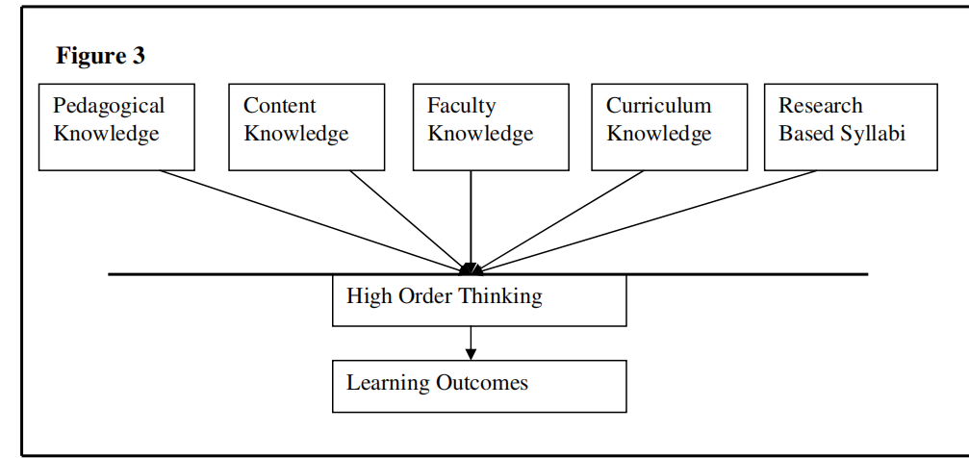

Slide 17
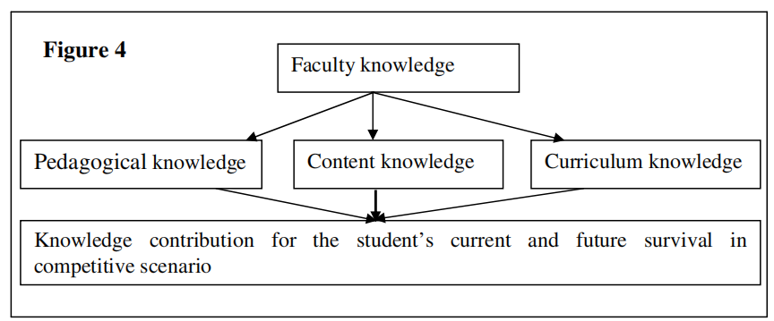

Slide 18
Research Based Syllabi. Recommendations for Business Schools
The first recommendation that teachers should do is research on same themes which they will teach to the students, it will enhance the thinking about why they teach specific ideas to the students.
The teachers should know much more about teaching subject matters and up-to-date concepts than not just translate or influence content knowledge.
Teachers can try new methods of exploring how the students are thinking about the concepts. Teachers should ask students about how and what they understand (not in the sense of assessment, but in the sense of interview) and they have to try to get inside their heads and see their ideas from their point of view.
Business schools have to support and encourage teachers to involve in collaborations with their teaching peers.

Slide 19
Teachers should involve in action research projects with their peers and students.
Teachers must cultivate the culture where they attend conference, workshops, faculty development programme, management development programme and seminars in national, regional and international level.
Business schools have to allocate less number of subjects in each semester, try to push them to redesign the syllabi for every year by doing rich research. It gives quality of education.
Teachers have to associate with teaching associations in national, regional and international wide.
Time Management, techniques must be used as syllabus coverage is given utmost importance in the universities. This needs time bound completion of several academic activities.
Figure 5 gives clear picture of how research based teaching play significant role in the placement of the students and how it makes lot of changes in all the areas of pedagogical knowledge, content knowledge, curriculum knowledge and faculty knowledge as well.

Slide 20
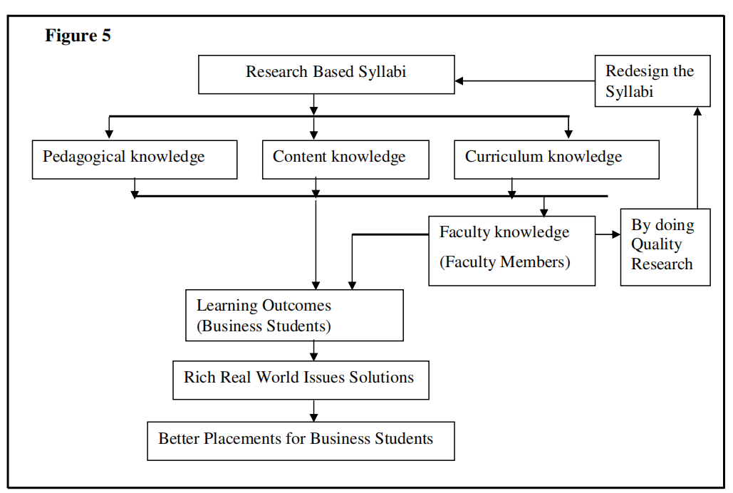

Slide 21
To support students’ learning and growth towards professionalism, it is important for teachers to understand the diverse nature of professional expertise and the ways of supporting its development in an ever-changing world .
The core of expertise is diversiﬁed know how and progressive problem solving, which lead to reformulating and rethinking tasks and problems at new and more complex levels

Slide 22
THEME Development of integrative, multidimensional and responsible expertise | SUB THEME Progressive and collaborative problem solving; deliberate practice; integrative pedagogy (integration of theory and practice); reﬂectivity and wisdom; agency and professional identity; ethics, responsibility, and sustainability; generic skills
Learning theories, approaches to learning and teaching, and teacher beliefs | Learning theories; practices promoting active and interactive learning; versatile teaching, learning and assessment methods; reﬂectivity in learning; personal learning goals; student-centred guidance practices; teacher beliefs

Slide 23
THEMES Curriculum work and development of teaching | SUB-THEMES Different curriculum models (e.g., connective, competence-based, and problem-based); constructive alignment; agency in the continuous development of teaching
Global, societal, and labour-market needs | Future competences and supporting students' employability; sustainable development and learning; digitalisation and globalisation; continuous learning and development; collaboration with workplaces

Slide 24
THEME Integration of versatile learning environments | SUB THEMES Integration of technology into teaching and learning; integration of work, extra-curricular activities, and community engagement with theoretical education; learning ecologies and ecosystems
Well-being as a part of learning | Knowledge, methods, and practices related to the promotion of the well-being of students and teachers; supportive atmosphere; participatory forms of studying and working; ﬂexible and meaningful study directions
Collaborative aspects in learning, teaching, and broader work of teachers | Working together; networking activities; sharing of knowledge, experiences and good practices; dialogue and peersupport; innovative knowledge communities and collaborative work culture

Slide 25
THEMES Internationalisation and interculturality | SUB-THEMES Interculturality in education and employment; linguistic and cultural sustainability; diversity; content and language-integrated learning (CLIL) and other multilingual methods; inclusion, equality, and equity
Pedagogical leadership | Leading curriculum work and the development of pedagogy; supporting a positive and collaborative work and teaching culture; involving participants and listening to their needs

Slide 26
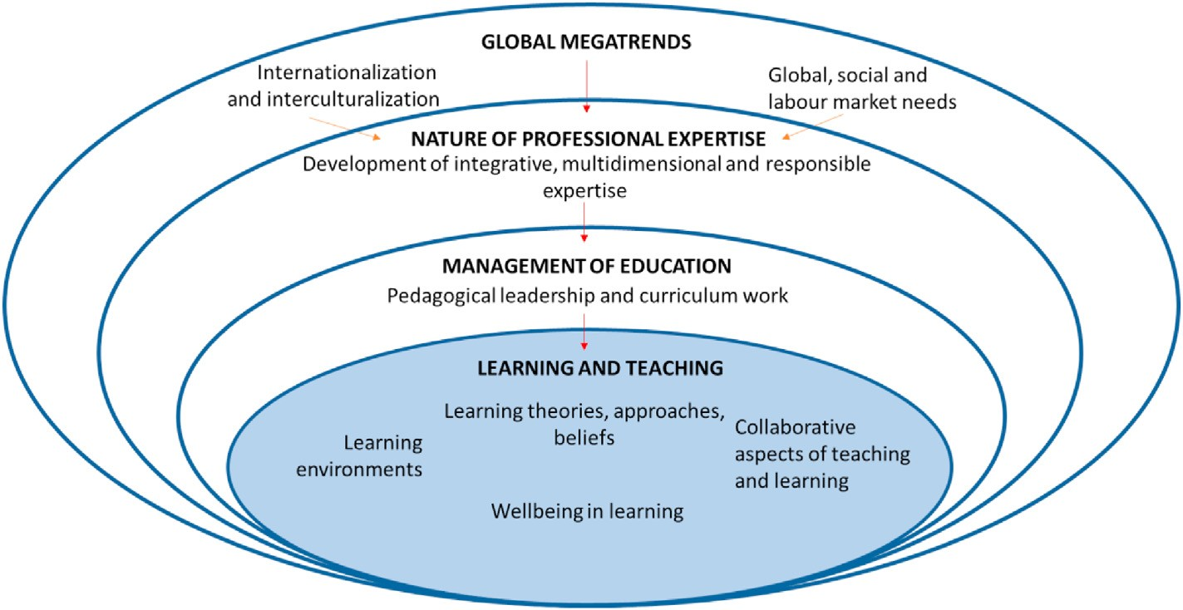
Relationships between the identiﬁed themes related to university pedagogy

